Slide 1
Computer Networks
From Andrew S. Tanenbaum
Computer Networks
Latest Edition

Slide 2
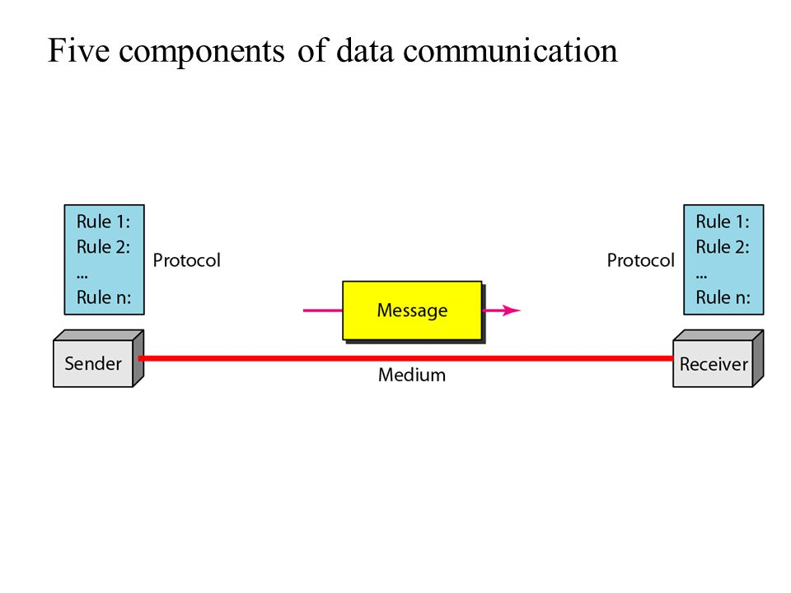
DATA COMMUNICATION
Data Communication is the exchange of data between two devices via some form of transmission medium (such as wire cable)
Components: Data communication has five components
  Sender: Device that sends the message. It can be computer, workstation, telephone handset, television and so on
  Receiver: Device that receive message sent by the sender. It can be computer, workstation, , telephone handset, television and so on
  Message: Information or data to be communicated. (Text, number, audio, image, Video)
  Transmission Medium: A physical path by which a message travel from sender to receiver. Example twisted pair wire, Coaxial cable, fiber optic, radio wave etc.
  Protocol: Set of rules that govern the data communication

Slide 3
DATA COMMUNICATION
Effectiveness of a data communication system depends on:
Delivery: The system must deliver data to the correct destination.
Accuracy: The system must deliver the data accurately (without any change/alteration).
Timeliness: The system must deliver the data in a timely manner. In the case of video and audio, timely delivery means delivering the data as they are produced, in the same order, that they are produced, and without significant delay. This kind of delivery is called real-time transmission.
Jitter: Jitter refers to the variation in the packet arrival time. It is the uneven delay in the delivery of audio or video packet

Slide 4
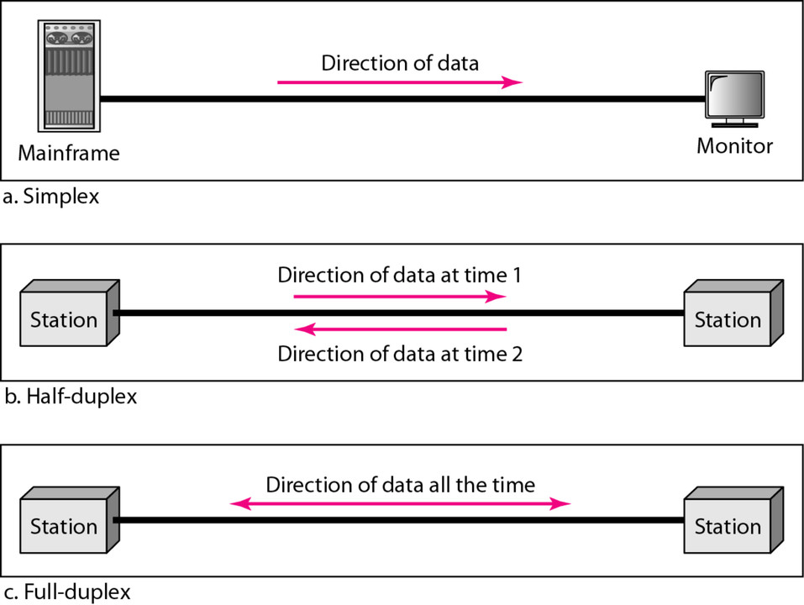
Data Flow (Transmission Mode)
Communication between two devices can be Simplex, Half duplex and full duplex

Slide 5
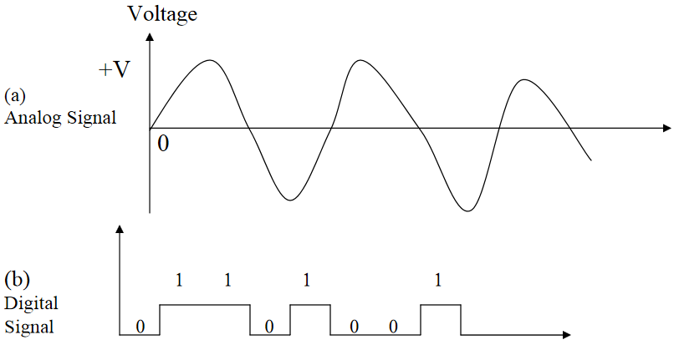
Analog and Digital Transmission
Data is transferred from one point to another point by means of electrical signals, which may be in digital or analog form.
In an analog signal the transmitted signals (Power) varies over a continuous range, for example sound, light and radio waves.
In a digital signal, the signal is a sequence of voltage pulses represented in binary form, ON or OFF ( 1 or 0 ).

Slide 6
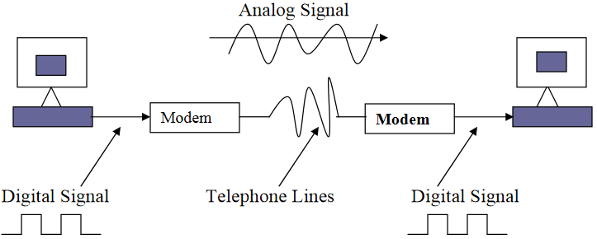
Analog and Digital Transmission
Computer generated data is digital whereas the telephone lines used for data communication in computer networks are usually meant for carrying analog signals.
When a digital data are to be sent over an analog facility, the digital signals must be converted to analog form.
The technique by which a digital signal is converted to its analog form is known as modulation. The reverse process, i.e., conversion of analog signal to its digital form, at a destination device, is called a de-modulation.
Because, today we do not have all-digital or all-analog networks; we have a mix of the two. Therefore, at various points in a network, it is necessary to convert between the two signal types.

Slide 7
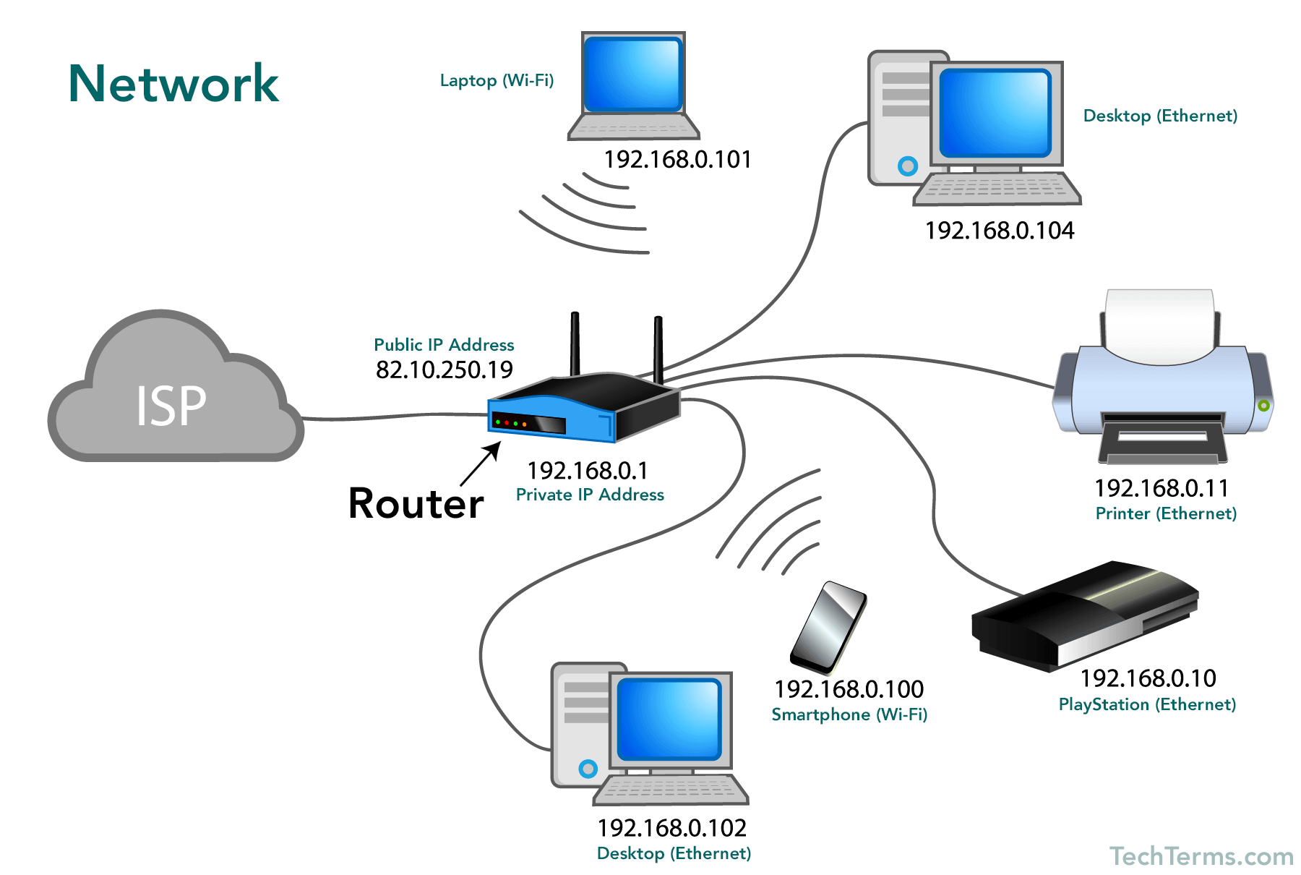
NETWORK
A network is a devices (also referred to as nodes) connected by communication link.
A node can be computer, printer or any other device capable of sending or receiving data generated by other node on the network

Slide 8
COMPUTER NETWORKS
Computer network is a telecommunication network which allows digital devices(nodes) to exchange data between each other using either wired or wireless connection to share hardware or software resources.
A group of computers interconnected by single technology.
Network Criteria: A network must be able to meet certain criteria:
    Performance
        Performance of a network depends on a number of factors including number of users, type of transmission medium, capabilities of connected hardware, and efficiency of software.
        Performance is often evaluated by two networking metrics: throughput and delay. We often need more throughput and less delay.
    Reliability
    In addition to accuracy of delivery, network reliability is measured by the frequency of failure, the time it takes a link to recover from a failure, and the network’s robustness in a catastrophe.
    Security
    Network security issues include protecting data from unauthorized access and damage

Slide 9
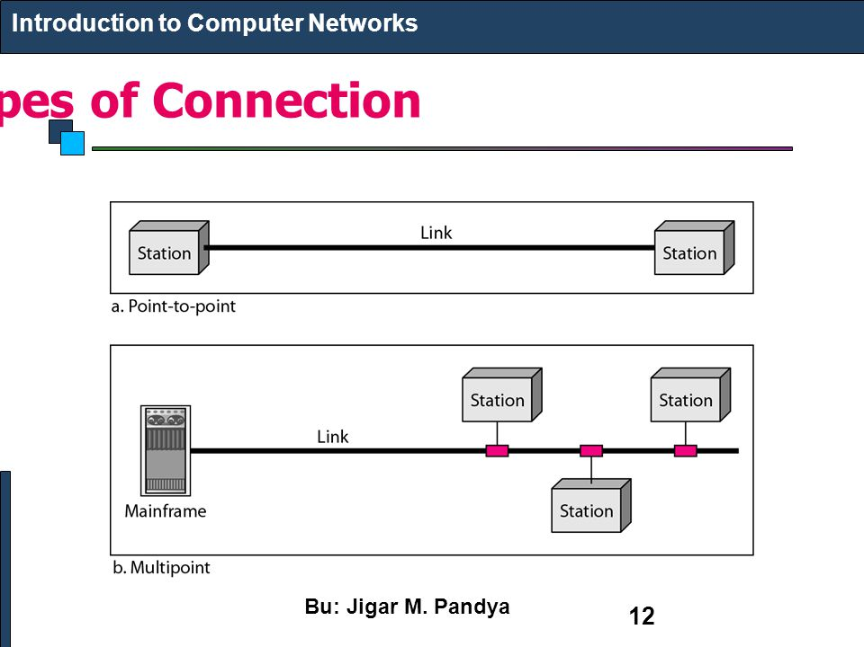
Physical Structure (Types of connection)
Link is the physical communication pathway that transfers data from one device to another.
Line Configuration refers to the way two or more communication devices attach to a link. Two types of connections (Line Configuration):
    Point-to-Point
    Multipoint

Slide 10
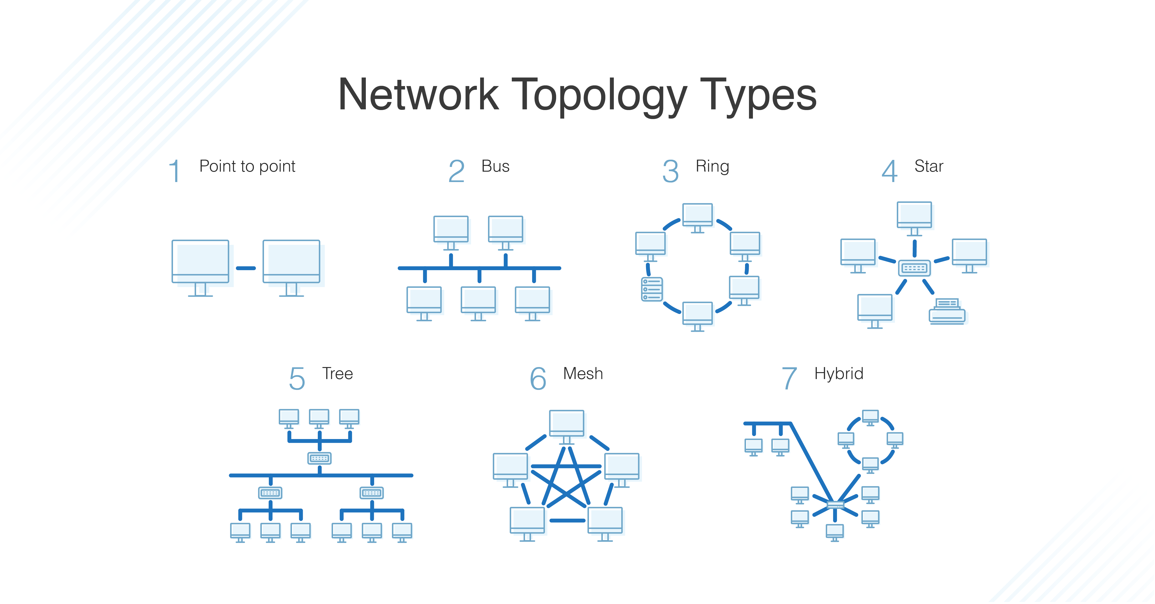
Physical Topology
Topology: The term topology refers to the way a network is laid out physically.
The topology of a network is the geometric representation of the relationship of all the links and linking devices (usually called nodes) to each other.

Slide 11
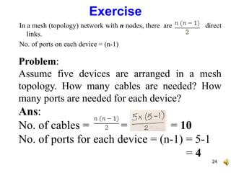
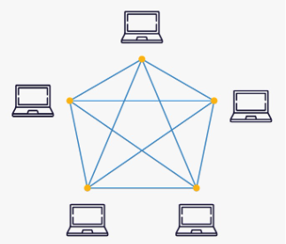
Mesh Topology
Every device has a dedicated point-to-point link to every other device.
Advantages:
Mesh topology is robust
Better privacy and security
Failure of one link will not disturb other links
Helps the network manager to find the fault location and solution
Disadvantages:
Large amount of cabling and I/O ports are required.
Installation and reconnection are difficult. Physical Structures Physical Topology

Slide 12
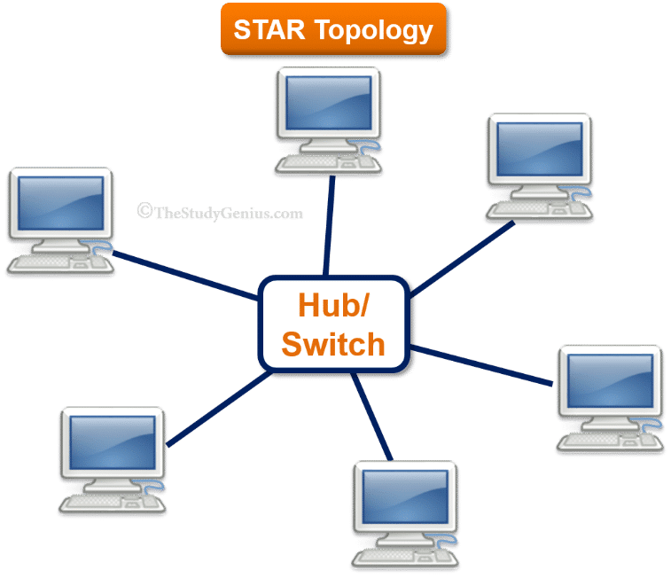
Star Topology
Every device has a dedicated point-to-point link to a central controller (HUB) only. In a Star topology network with n nodes, there are direct n links
Advantages:
Star topology is robust.
Less expensive.
Fault identification and fault isolation are easy.
Modification of star network is easy.
Disadvantages:
If the central hub fails, the whole network will not work.
Communication is possible through the hub.

Slide 13
Bus Topology
One long cable acts as a backbone to link all the devices in the network
Advantages:
Easy Installation.
Less cabling and less number of I/O ports is required.
Less cost.
Disadvantages:
Network traffic is high.
Adding new device is difficult.
A break in the bus cable stops all transmissions
Ring Topology
Each device has a dedicated point-to-point link with only the two devices on either side of it. A signal is travelling along a ring in only one direction from device to device until it reaches its destination. The repeater is used to regenerate the signals during transmission.
Advantages:
Easy to install and reconfigure.
Link failure can be easily found out.
Disadvantages:
Maximum length of ring and number of devices are limited.
Failure of one node on the ring affects the entire network.
Addition of nodes or removal of nodes disrupts the network.
Signal traffic is unidirectional.

Slide 14
Network Hardware
Local Area Networks
Metropolitan Area Networks
Wide Area Networks
Wireless Networks
Home Networks

Slide 15
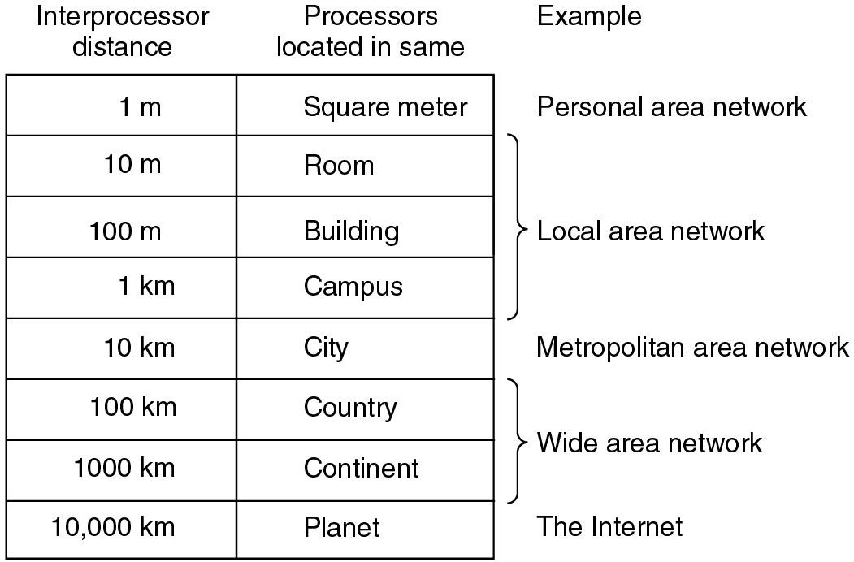
Interconnected processors by scale
Classification of interconnected processors by scale.

Slide 16
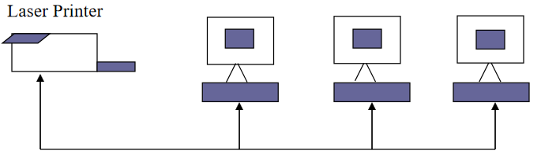
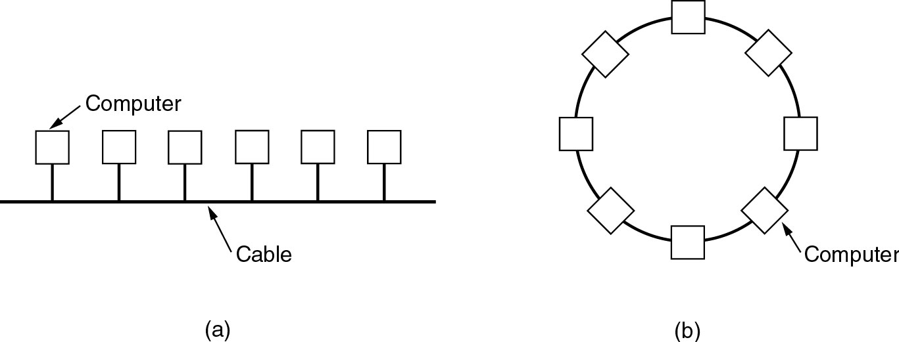
Computer Networks - Introduction
Local Area Networks (LAN)

Slide 17
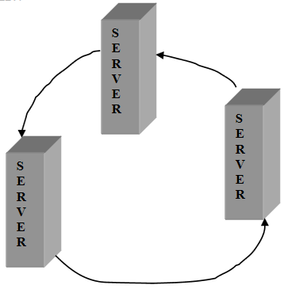
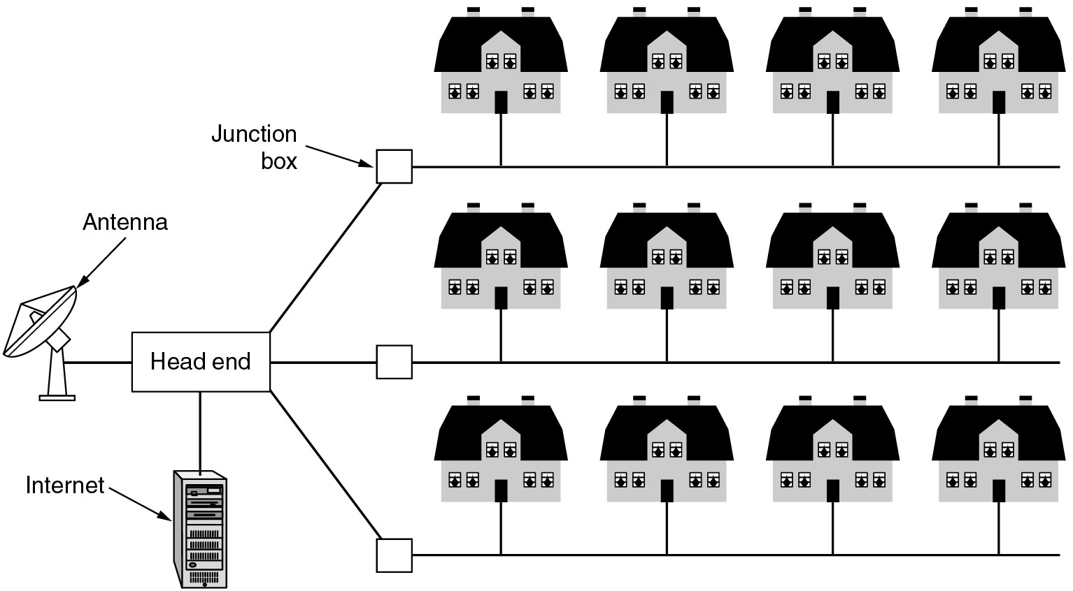
Computer Networks - Introduction
Metropolitan Area Networks (MAN)

Slide 18
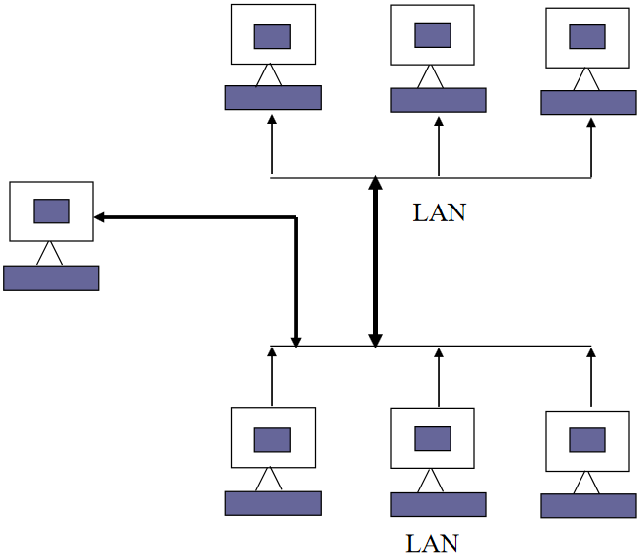
Computer Networks - Introduction
Wide Area Networks (WAN)

Slide 19
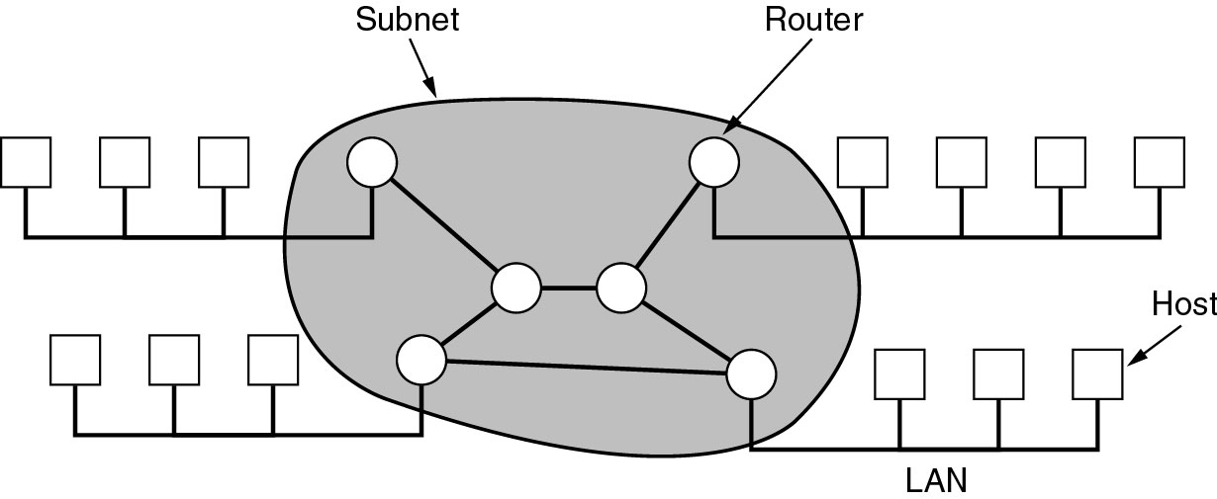
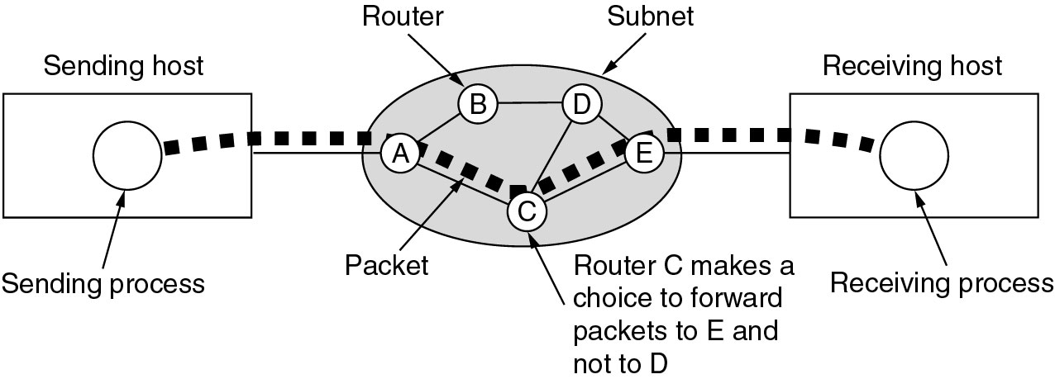
Computer Networks - Introduction
Wide Area Networks (WAN)

Slide 20
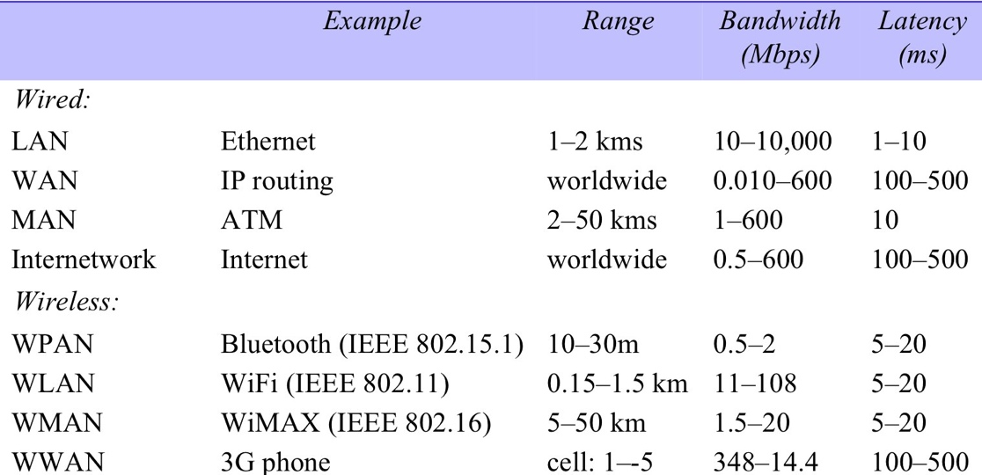
Types of networks
Figure 1: Network performance
km
Notes:
ATM networks are specifically designed to provide high bandwidths and low latencies & to support QoS by reservation of network resources.

Slide 21
Uses of Computer Networks
  Business Applications
  Home Applications
  Mobile Users
  Social Issues

Slide 22
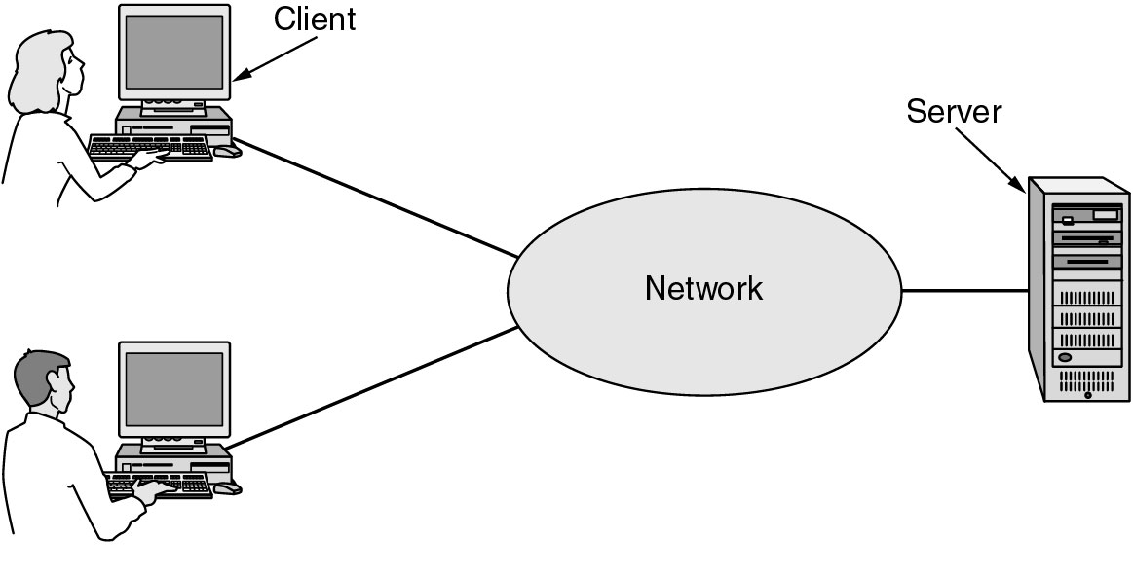
Business Applications of Networks
A network with two clients and one server.

Slide 23
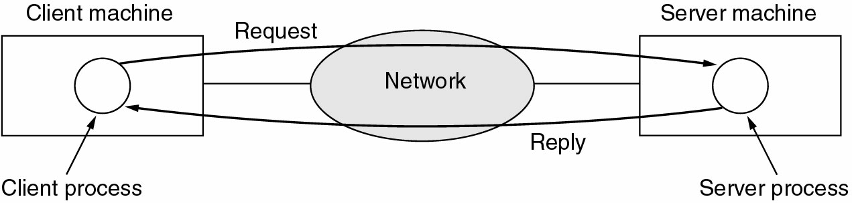
Business Applications of Networks (2)
The client-server model involves requests and replies.

Slide 24
Home Network Applications
Access to remote information
Person-to-person communication
Interactive entertainment
Electronic commerce

Slide 25
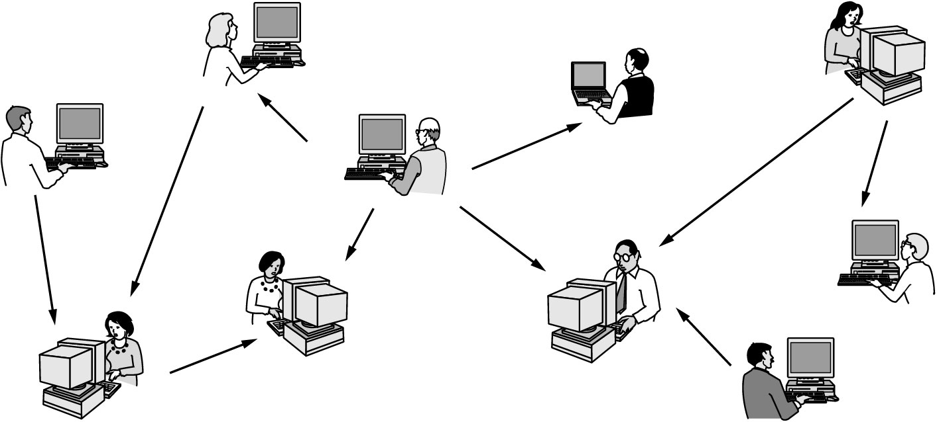
Home Network Applications (2)
In peer-to-peer system there are no fixed clients and servers.

Slide 26
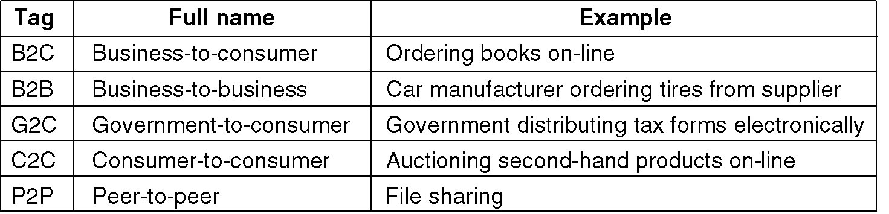
Home Network Applications (3)
Some forms of e-commerce.

Slide 27
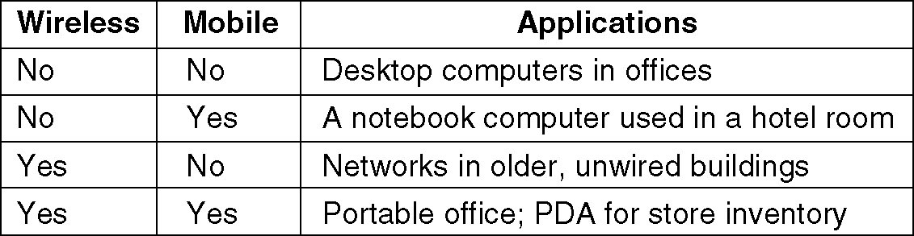
Mobile Network Users
Combinations of wireless networks and mobile computing.

Slide 28
What is a Protocol?
In data communication, a protocol is a set of rules and procedures established to control transmission between two points so that the receiver can properly interpret the bit stream transmitted by the sender. Protocols are the data communications software. An example of a human communications protocol can be found in a classroom and traffic rules etc. In any computer network, protocols perform the following functions for the efficient & error free transmission of data:
Data Sequencing.
Data Routing.
Flow Control.
Error Control.
Precedence and order of Transmission.
Connection Establishment.
Data Security.
Log Information.

Slide 29
Switching
Connectivity:
Whenever we have multiple devices, we have the problem of how to connect them to make one-on-one communication possible.
One solution is to install a point-to-point connection between each pair of devices (mesh topology) or between a central device (hub) and every other device (star topology).
However, these methods are impractical and wasteful when applied to very large networks.
The number and length of the links require too much infrastructure to be cost efficient, and the majority of those links would be idle most of the time.
In Bus topology, the distances between devices and the total number of devices increase beyond the capacities of the media and equipment.
A better solution is switching.

Slide 30
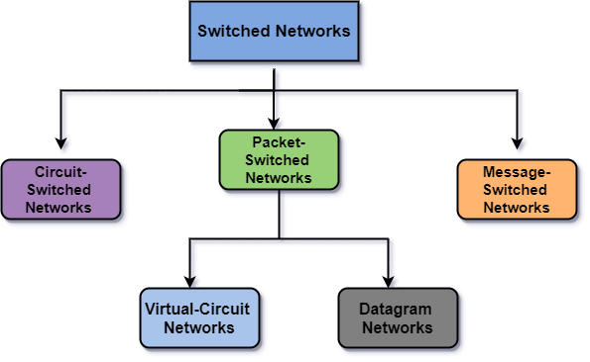
Switched Network
A Switched network consists of a series of interlinked nodes, called Switches.
Switches are devices capable of creating temporary connections between two or more devices linked to the switch.
In a switched network, some of these nodes are connected to the communicating devices (e.g. telephones). Others are used only for routing.
The concept of switching is needed for the effective utilization of the bandwidth. Also whenever two or more devices communicate with each other then there are many chances for the occurrence of the collision of data packets in the network; switching is the best solution for this problem.

Slide 31
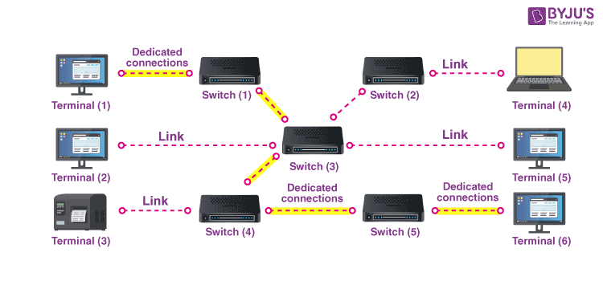
Circuit Switched Network
Circuit switching technique is a connection-oriented network that is divided into pieces and has a dedicated path established between the sender and receiver providing a guaranteed data rate.
Circuit Establishment
  A dedicated circuit between the source and the destination is established with the help of numerous intermediate switching centres.
Data Transfer
  The transfer of data and voice signals are possible between the source and the destination after the establishment of the circuit.
Circuit Disconnection
  The disconnection in the circuit happens when one of the users initiates to disconnect. When the disconnection takes place, all the intermediate links between the sender and receiver are removed.

Slide 32
Advantages and Disadvantages of Circuit Switched Network
Advantages of Circuit Switching
Offers Dedicated Transmission
No Delay in Transmission
The Circuit Switching technique is best for long transmission because it facilitates a dedicated link between sender and receiver.
Disadvantages of Circuit Switching
Dedicated path between sender and receiver cannot be used by any other device.
There is a need for more bandwidth as a dedicated path requires more bandwidth.
Utilization of resources is not done properly as resources are allocated to a connection for the entire duration and thus became unavailable for all other connections.
Inefficient in the case if the connection is established between sender and receiver but there is no data transfer between them.

Slide 33
Packet Switching
Packet Switching is a technique of switching in which the message is usually divided into smaller pieces that are known as packets.
Each packet contains complete addressing or routing information (Destination Address, Source Address, Total number of pieces, Sequence number - - written in the header section of packet)
One of the biggest examples of the Packet-switched network is the Internet.
Connection-oriented Packet-switched Network: Data packets are sent sequentially over a predefined route. (Fixed path between a source and destination is established prior to transfer of packets.) Packets are assembled, given a sequence number and then transported over the network to a destination in order. In this mode, address information is not required. This is also known as virtual circuit switching.
In Datagram Switching, the packet is commonly known as a datagram. Datagram Packet switching is also known as Connectionless Packet Switching. In this technique, each packet routed individually by network devices on the basis of the destination address that is contained within each packet.

Slide 34
Packet Switching
Advantages of Packet Switching
More efficient utilization of bandwidth.(The same channel can be used by many users simultaneously).
Latency in the transmission is minimum in packet switching.
As there are improved protocols, thus packet switching is used by many applications like Skype, WhatsApp, etc.
The fault tolerance in this technique is more in case of any link down because packets may follow different paths.
Disadvantages of Packet Switching
This technique cannot be used by those applications that cannot afford more delays like applications of high-quality voice calls.
In the case of an overloaded network, the packet may get lost or there might occur delay which causes the loss of critical information.
On the receiver's side sorting of the packets sent by the sender is required.

Slide 35
Message Switching
Message switching is a method in which the whole message is stored in a switch and forwarded when a route is available.
Advantages of Message Switching:
Efficient traffic management
Reduces network traffic congestion
Efficient use of transmission control
Disadvantages of Message Switching:
Because of store and forward, transmission delay
Each node requires large capacity for storing.

